Slide 1
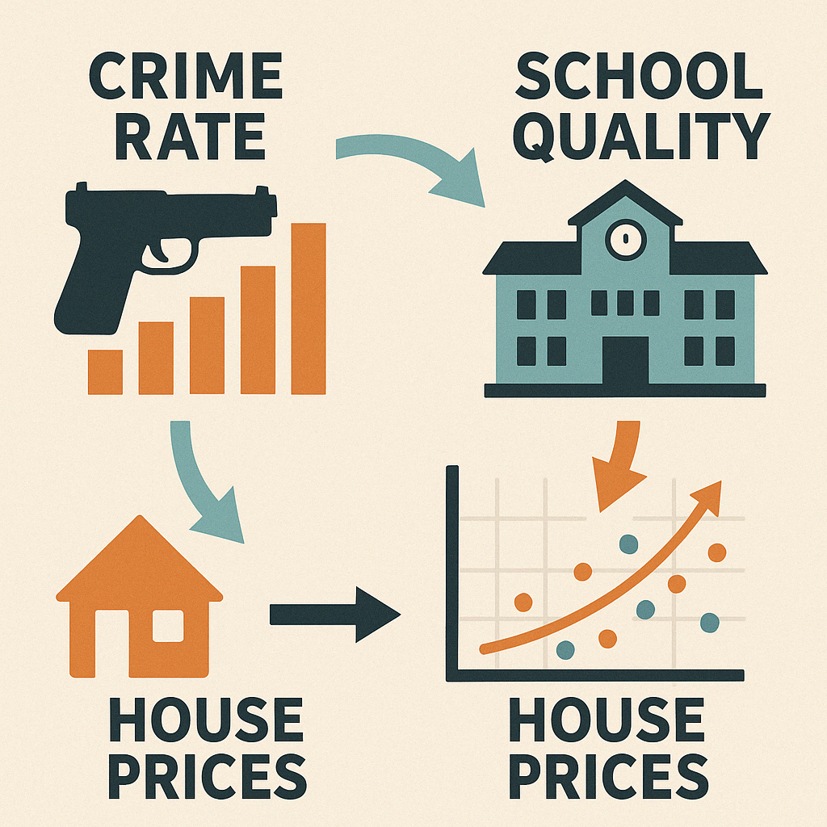
04/17/25
DSCI 4780 / 6780
House Prices Correlation
w/ Crime Rate & School Quality
Semester: SPRING 2025
Team: THE TECH TITANS
Members:
Tom Dibble Dempsey
Cyron Trazona
Angel Nivar
Jack Coleman
Omar Majitov
Sanjib K C

Slide 2
TABLE OF CONTENTS
1
2
3
4
5
6
7
Motivation and Background
Problem Statement
Data Science pipeline
Methodology
Evaluation
Lessons Learned
Summary

Slide 3
CYMBAL
PRODUCT OVERVIEW
Motivation and Background
CYMBAL
PRODUCT OVERVIEW

Slide 10
CYMBAL
PRODUCT OVERVIEW
Problem Statement
CYMBAL
PRODUCT OVERVIEW

Slide 11
CYMBAL
PRODUCT OVERVIEW
Data Science pipeline
CYMBAL
PRODUCT OVERVIEW

Slide 12
CYMBAL
PRODUCT OVERVIEW
Methodology
CYMBAL
PRODUCT OVERVIEW

Slide 13
CYMBAL
PRODUCT OVERVIEW
Evaluation
CYMBAL
PRODUCT OVERVIEW

Slide 14
CYMBAL
PRODUCT OVERVIEW
Lessons Learned
CYMBAL
PRODUCT OVERVIEW

Slide 15
Summary
CYMBAL
PRODUCT OVERVIEW

Slide 17
CONTACT
PRODUCT OVERVIEW
Please feel free to reach out with any
Questions, compliments, or concerns.
Email: no_reply@example.com
Tel: (123)456-7890
IG: @[insert handle]

Slide 18

THANK YOU
We look forward to
working together with you.

